Slide 1


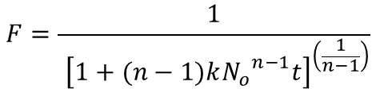














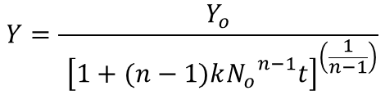
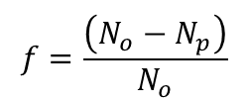

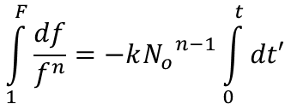

Hyberbolic deactivation model of n^{th} order (based on sites)
$$\frac{dN_{p}}{dt′} →Rate of poisoning$$
$$F=\frac{1}{{ \left[1+(n−1)k{N_{o}}^{n−1}t\right]}^{\left(\frac{1}{n−1}\right)}}$$
$N_{o}$ →
No. of active sites at time = 0
$N_{p}$ → No. of sites poisoned
$$\frac{dN_{p}}{dt′}=k{\left(N_{o}−N_{p}\right)}^{n}$$
$$F=\frac{Y}{Y_{o}}$$
$k$ →
Intrinsic Deactivation constant
$$−N_{o}\frac{df}{dt′}=k{N_{o}}^{n}f^{n}$$
$f$ → Fraction of sites active
…using (1), (2), (3)
$$Y=\frac{Y_{o}}{{ \left[1+(n−1)k{N_{o}}^{n−1}t\right]}^{\left(\frac{1}{n−1}\right)}}$$
$$f=\frac{\left(N_{o}−N_{p}\right)}{N_{o}}$$
(1)
$$\frac{df}{dt′}=−k{N_{o}}^{n−1}f^{n}$$
$N_{p}=$ $N_{o}(1−f)$
(2)
$$\left(N_{o}−N_{p}\right)={fN}_{o}$$
(3)
$$\int_{1}^{F}{\frac{df}{f^{n}}}=−k{N_{o}}^{n−1}\int_{0}^{t}{dt′}$$
At $time=0$, $f=1$
$F$ →
Fraction of sites active at time t
$$\frac{F^{1−n}−1}{1−n}=−k{N_{o}}^{n−1}t$$
$Y$ →
Site-time Yield of product at time t
$$F^{1−n}=1+(n−1)k{N_{o}}^{n−1}t$$
$Y_{o}$ →
Site-time Yield of product at time = 0
$$F={ \left[1+(n−1)k{N_{o}}^{n−1}t\right]}^{\left(\frac{1}{1−n}\right)}$$

Slide 2






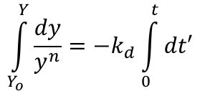





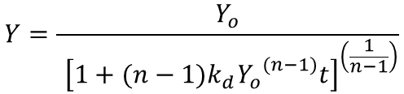

Hyberbolic deactivation model of n^{th} order (based on site-time yield)
$$\frac{dy}{dt′}=−k_{d}y^{n}$$
$y$ →
Product site-time yield
$$Y=Y_{o}{\left[1+(n−1)k_{d}Y_{o}^{(n−1)}t\right]}^{\left(\frac{1}{1−n}\right)}$$
$N_{p}$ → No. of sites poisoned
$$\int_{Y_{o}}^{Y}{\frac{dy}{y^{n}}}=−k_{d}\int_{0}^{t}{dt′}$$
$k_{d}$ →
Apparent deactivation rate constant
$$Y=\frac{Y_{o}}{{ \left[1+(n−1)k_{d}{Y_{o}}^{(n−1)}t\right]}^{\left(\frac{1}{n−1}\right)}}$$
$$\frac{Y^{1−n}−Y_{o}^{1−n}}{1−n}=−k_{d}t$$
At $time=0$, $y=Y_{o}$
$Y$ →
Site-time Yield of product at time t
$$Y^{1−n}=Y_{o}^{1−n}+(n−1)k_{d}t$$
$$Y={ \left[Y_{o}^{1−n}+(n−1)k_{d}t\right]}^{\left(\frac{1}{1−n}\right)}$$
$Y_{o}$ →
Site-time Yield of product at time = 0
$$Y=Y_{o}{\left[1+(n−1)k_{d}Y_{o}^{−(1−n)}t\right]}^{\left(\frac{1}{1−n}\right)}$$

Slide 3
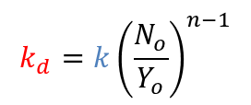
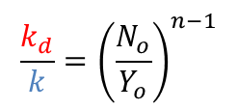

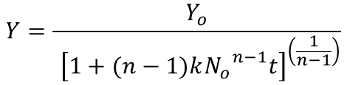
Correlation between apparent and intrinsic deactivation constants
$$Y=\frac{Y_{o}}{{ \left[1+(n−1)k{N_{o}}^{n−1}t\right]}^{\left(\frac{1}{n−1}\right)}}$$
$$Y=\frac{Y_{o}}{{ \left[1+(n−1)k_{d}{Y_{o}}^{(n−1)}t\right]}^{\left(\frac{1}{n−1}\right)}}$$
Comparing above two equations –
$$k{N_{o}}^{n−1}=k_{d}{Y_{o}}^{(n−1)}$$
$$\frac{k_{d}}{k}={\left(\frac{N_{o}}{Y_{o}}\right)}^{n−1}$$
The apparent deactivation constant (k_{d}) is a function of the order (n), and thus it is not a “true” independent parameter
$$k_{d}=k{\left(\frac{N_{o}}{Y_{o}}\right)}^{n−1}$$

